Slide 1

CLOUDFRONT WITH S3 BUCKET
Under the guidance of
MS.S.NANDINI
By
ATLA JAGADISHWAR REDDY
(41110147)

Slide 2
PRESENTATION OUTLINE
Cource Certificate
Abstract
Introduction
Literature review
Objectives
Requirements
Amazon Cloudfront and S3 Overview
Architecture
Creation of S3 bucket and Cloud Distribution
Output
Conclusion
Refernce

Slide 3
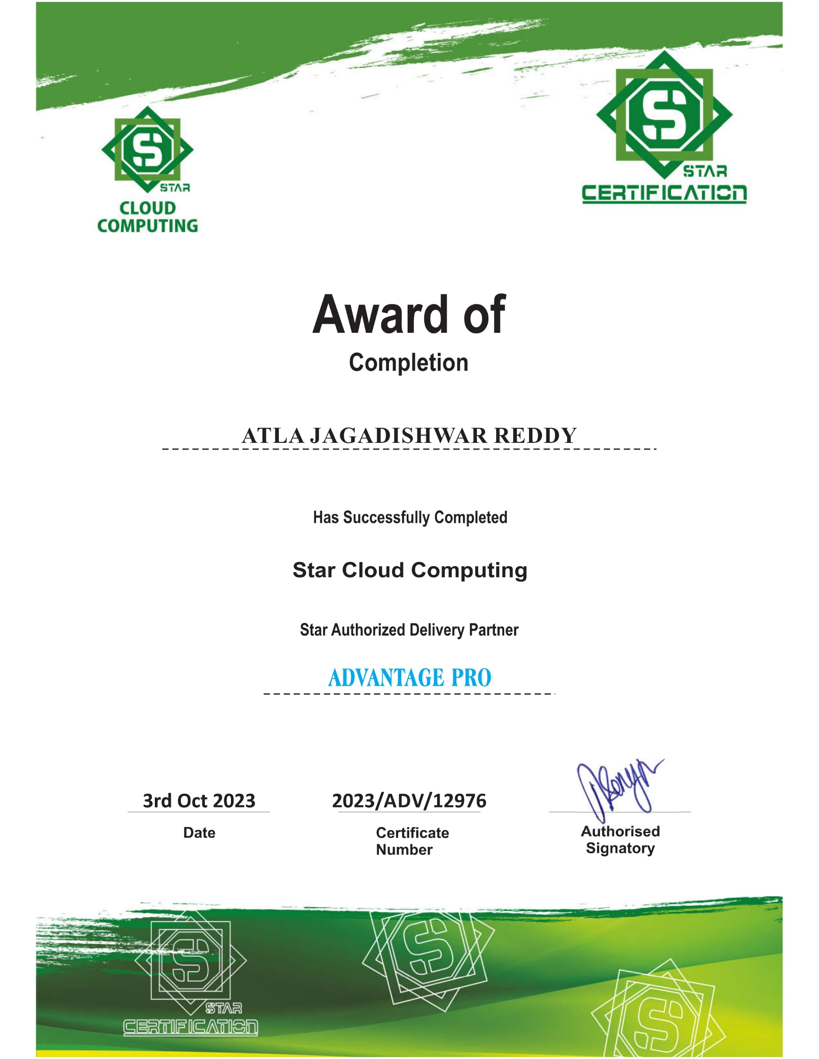
CERTIFICATE

Slide 4
ABSTRACT
This abstract explores the integration of CloudFront, Amazon's content delivery network (CDN) service, with Amazon Simple Storage Service (S3), a widely used object storage service. This integration combines the power of CloudFront's global edge locations for content delivery with the scalability and durability of S3 for storage.
In this abstract, we delve into the key benefits of integrating CloudFront with S3, including reduced latency, enhanced reliability, and simplified content management. We also discuss practical use cases and best practices for configuring this integration.
This abstract provides valuable insights for organizations seeking to optimize their content delivery strategies using Amazon's robust cloud services.

Slide 5
INTRODUCTION
Amazon CloudFront is a content delivery network (CDN) service that securely delivers data, videos, applications, and APIs to customers globally with low latency, high transfer speeds, all within a developer-friendly environment.
CloudFront works seamlessly with Amazon Simple Storage Service (Amazon S3) to accelerate the delivery of your web content and reduce the load on your origin servers.
Amazon S3 is an object storage service that offers industry-leading scalability, data availability, security, and performance. S3 is designed to store and retrieve any amount of data at any time, from anywhere on the web.

Slide 6
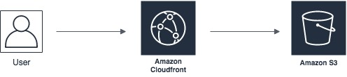
INTRODUCTION
When you use CloudFront with S3, you can deliver your content from CloudFront edge locations, which are located all over the world.
This means that your users will experience low latency and high transfer speeds, regardless of where they are located.

Slide 7
OBJECTIVES
Improved performance:
CloudFront is a content delivery network (CDN) that caches content at edge locations around the world.
By serving S3 objects with CloudFront, you can improve the performance of your application by reducing latency and improving load times for users located far away from the S3 bucket.
Reduced costs:
Serving S3 objects with CloudFront can help reduce your data transfer costs by caching frequently accessed content at edge locations.

Slide 8
OBJECTIVES
This reduces the number of requests made to the S3 bucket, which can help reduce your data transfer costs.
Improved security:
CloudFront can help improve the security of your S3 objects by enabling you to restrict access to your content using a variety of authentication methods, such as signed URLs or AWS Identity and Access Management (IAM) policies.
Customization:
CloudFront provides a range of customization options, such as custom SSL certificates, custom error pages, and content compression, which can help you optimize the delivery of your S3 objects to your users.

Slide 9
OBJECTIVES
Scalability:
CloudFront is designed to handle high levels of traffic and can automatically scale to accommodate increases in demand.
This can help ensure that your application remains highly available and responsive, even during periods of high traffic.

Slide 10
REQUIREMENTS
Software Requirements:
AWS Account
AWS CLI or SDKs
Service Requirements:
Amazon S3 Bucket
Amazon CloudFront Distribution
Configuration Requirements:
Content in S3
Security Configuration
Hardware Requirements
There are no specific hardware requirements for this.

Slide 11
Amazon Cloudfront Overview
Amazon CloudFront is a web service that speeds up distribution of your static and dynamic web content,such as .html, .css, .js, and image files, to your users.
CloudFront delivers your content through aworldwide network of data centers called edge locations.
When a user requests content that you'reserving with CloudFront, the request is routed to the edge location that provides the lowest latency (timedelay), so that content is delivered with the best possible performance

Slide 12
APPLICATIONS OF CLOUDFRONT
Content Delivery: CloudFront accelerates the delivery of your content by caching your content at edge locations worldwide. This reduces the time it takes for users to access your content and improves the performance of your web applications.
Video Streaming: CloudFront can deliver high-quality video streaming to users worldwide. It can also integrate with AWS Elemental Media Services to provide a complete video streaming solution.
Website Security: CloudFront integrates with AWS Shield to provide protection against DDoS attacks. It also supports SSL/TLS encryption to secure your content in transit.

Slide 13
AMAZON S3 Overview
Amazon Simple Storage Service (Amazon S3) is an object storage service that offers industry-leadingscalability, data availability, security, and performance.
Customers of all sizes and industries can useAmazon S3 to store and protect any amount of data for a range of use cases, such as data lakes,websites, mobile applications, backup and restore, archive, enterprise applications, IoT devices, andbig data analytics.
Amazon S3 provides management features so that you can optimize, organize,and configure access to your data to meet your specific business, organizational, and compliancerequirements.

Slide 14
FEATURES OF AMAZON S3 ?
Strong consistency
Storage classes
Storage management
Access management and security

Slide 15
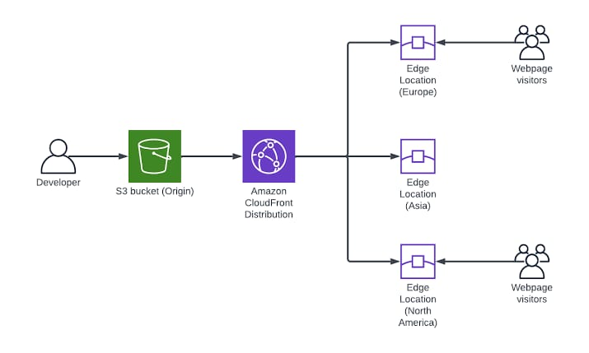
ARCHITECTURE

Slide 16
Setup the S3 and Cloudfront for serving objects
Sign in to AWS management console.
Create and setup the S3 Bucket (Private) to store objects.
Create the Cloudfront distrubution for your S3 bucket.
Setup the IAM role and permissions for Web application.
Finally, test the application !!!

Slide 17
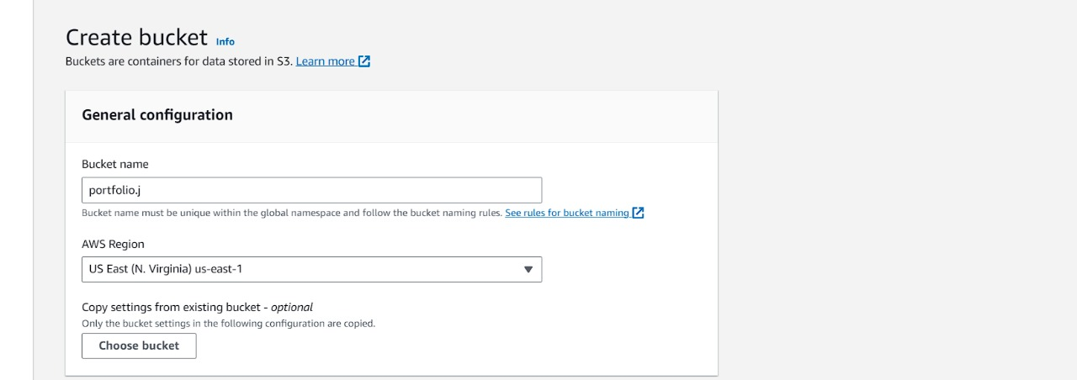
CREATION OF S3 BUCKET
Let's search for S3 and open th S3 console
Create S3 bucket:
Give a globally unique name and region to your bucket

Slide 18
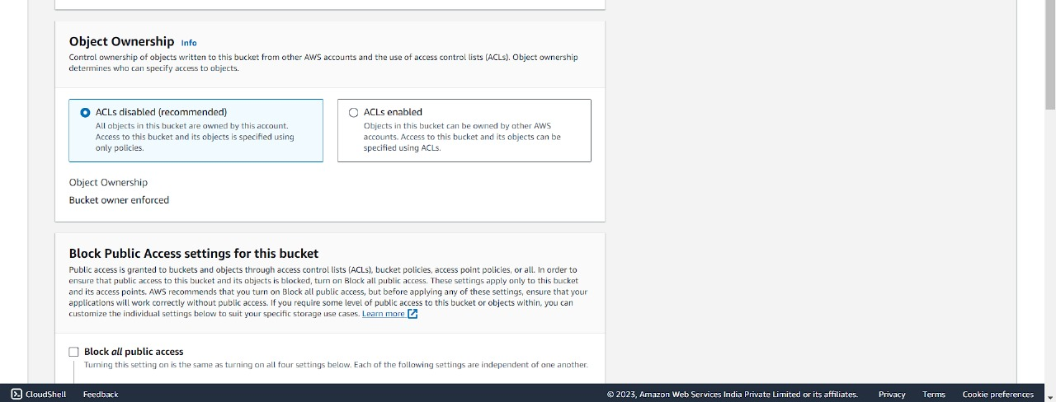
CREATION OF S3 BUCKET
Set the object ownership and keep ACL's disabled

Slide 19
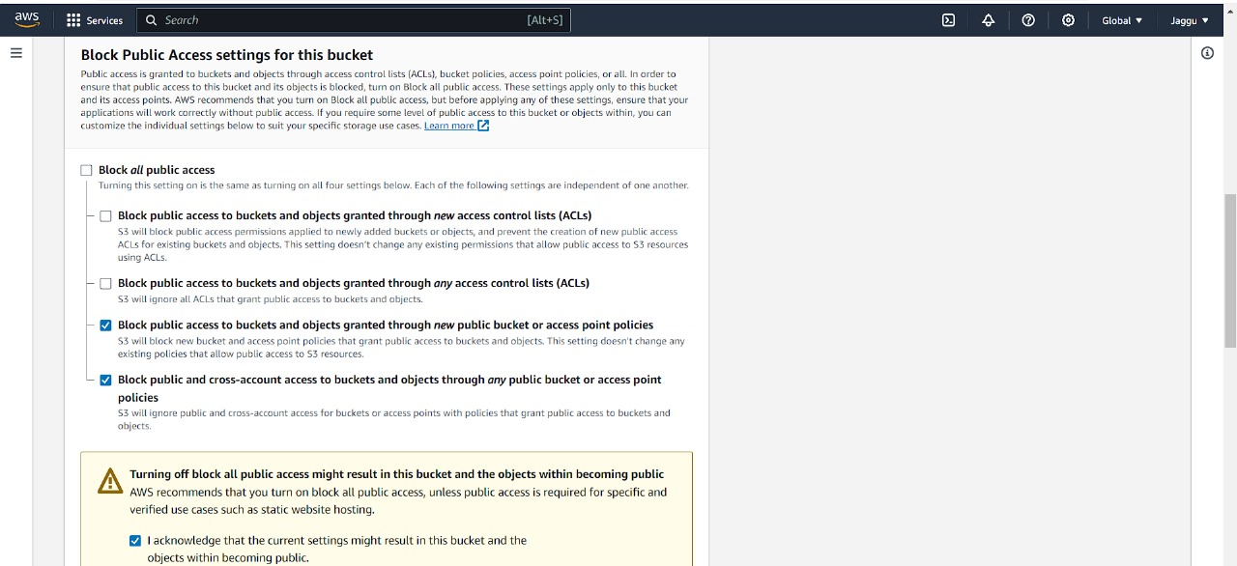
CREATION OF S3 BUCKET
Block public access settings for this bucket

Slide 20
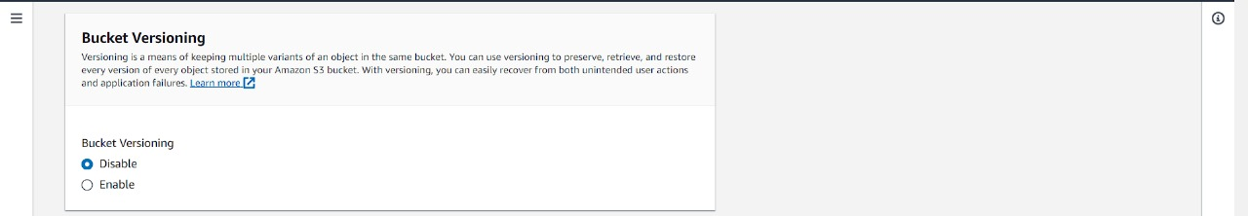
CREATION OF S3 BUCKET
Enable the versioning
With S3 versioning, every time an object is updated or deleted, a new version of the object is created, allowing users to access and restore previous versions of the object.

Slide 21
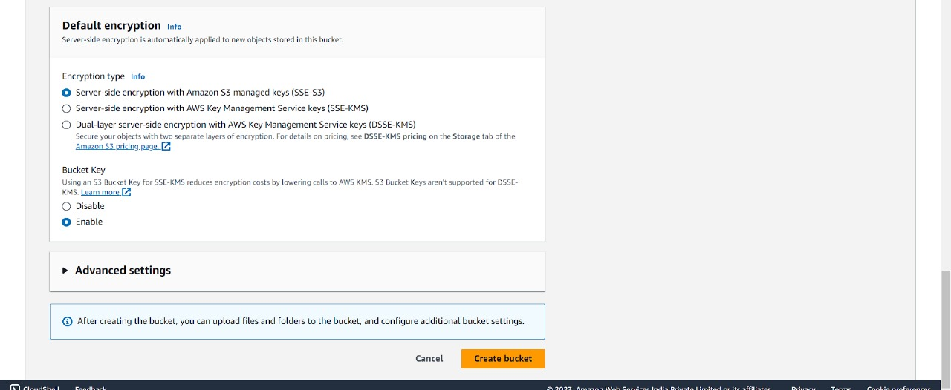
CREATION OF S3 BUCKET
Enable the encryption
In Server-side encryption, Amazon S3 encrypts your objects before saving them on disks in AWS data centers and then decrypts the objects when you download them.
Finally click on the create bucket

Slide 22
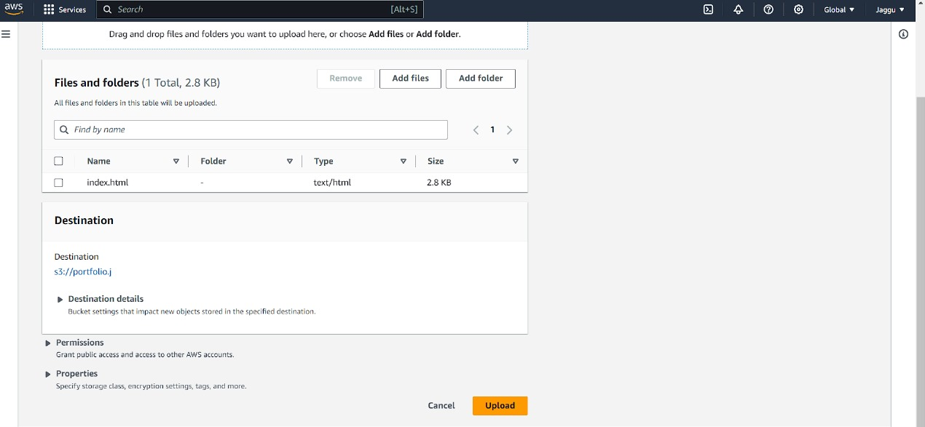
CREATION OF S3 BUCKET
Now let's upload some objects in S3 bucket for testing or project.

Slide 23
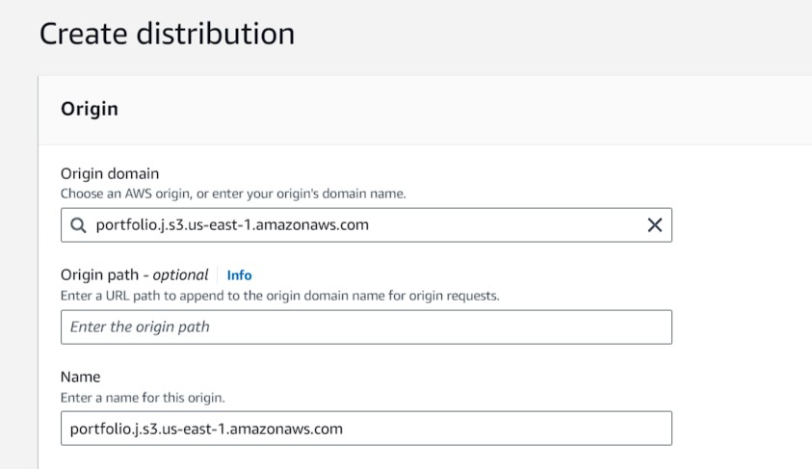
CREATE THE CLOUD DISTRIBUTION FOR S3
Search for cloudfront in AWS console search bar & open the cloudfront dashboard.Select the Origin domain of your bucket from drop down & give the name of the cloudfront distribution.

Slide 24
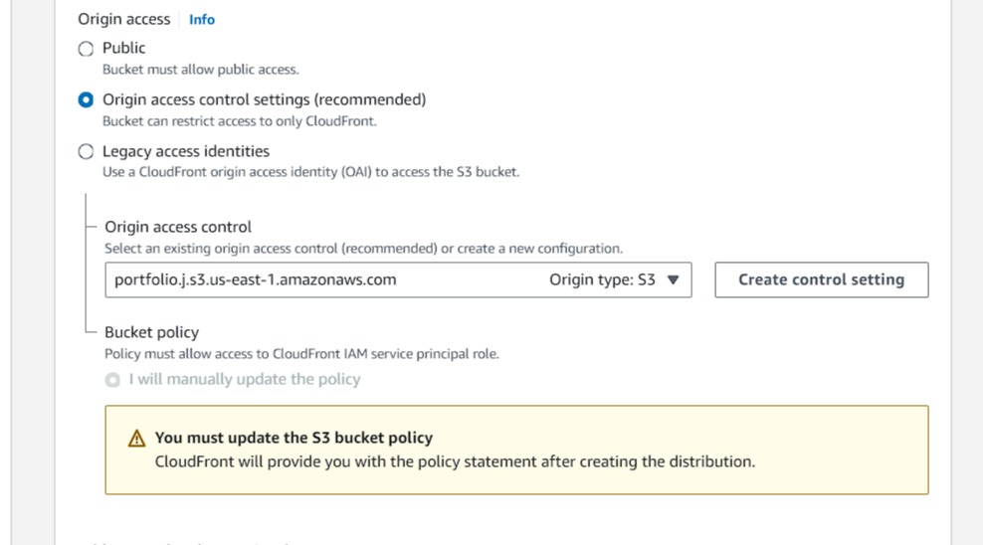
CREATE THE CLOUD DISTRIBUTION FOR S3
Set the origin access as Origin access control settings.

Slide 25
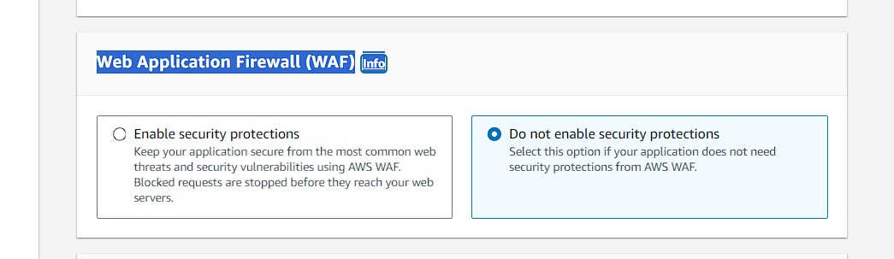
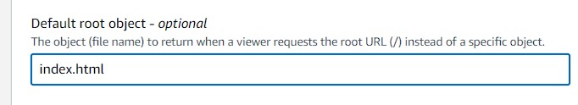
CREATE THE CLOUD DISTRIBUTION FOR S3
Web Application Firewall (WAF)
Give the default root object -
Click on the create distribution.

Slide 26
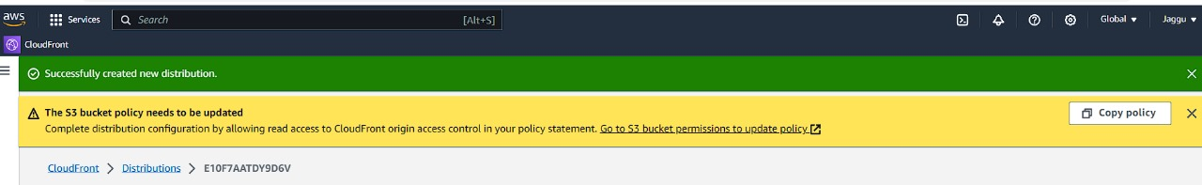
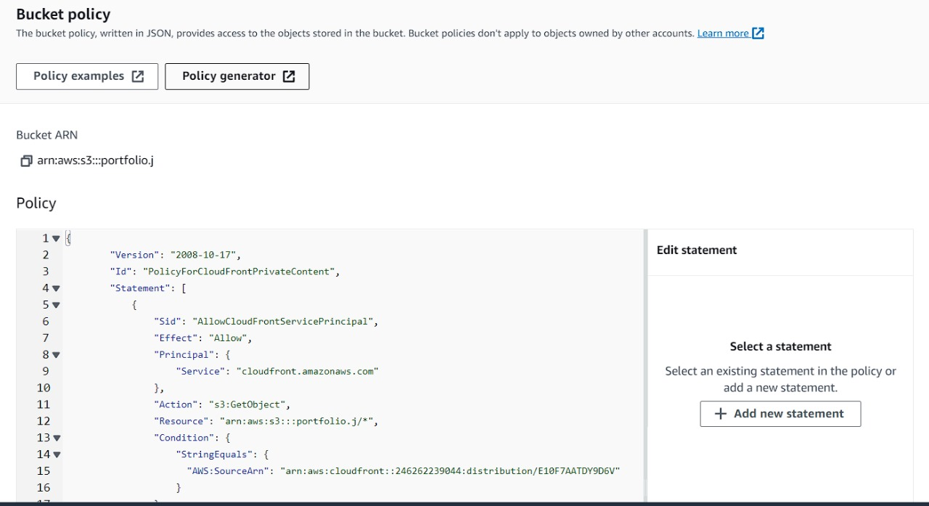
Once the Cloudfront Distribution got created then we need to add the given policy in the respective S3 Bucket policy. So copy the bucket policy from here.
Then go to S3 bucket > Permissions > Edit bucket policy.

Slide 27
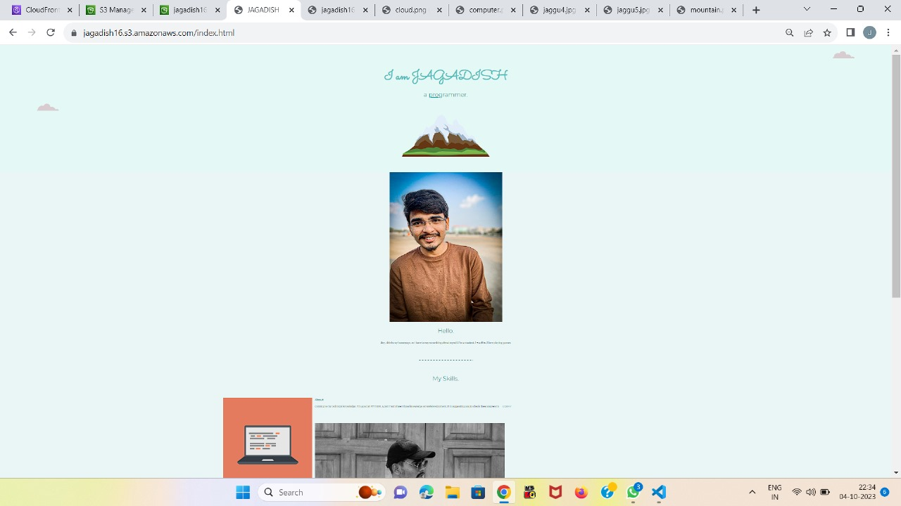
OUTPUT
Finally, test the Application !!
Now we can test the cloudfront domain which is setup to deliver the object from private S3 bucket
By hitting the, https://dkcq6g3wm5cc4.cloudfront.net/ll it will return as below.

Slide 28
CONCLUSION
The integrated security measures offered by CloudFront and S3 ensure data remains safeguarded throughout the content's lifecycle, from storage to distribution.
This is particularly valuable for businesses dealing with sensitive or mission-critical information.
The applications of CloudFront with S3 are vast and span industries such as website hosting, media streaming, software distribution, e-commerce, data backups, and more.
This integration caters to a wide spectrum of use cases, showcasing its versatility and adaptability.
As cloud computing continues to evolve, the partnership between Amazon CloudFront and Amazon S3 remains pivotal in modern IT architectures.

Slide 29
CONCLUSION
Its capacity to enhance content delivery, bolster security, minimize latency, and optimize costs positions it as a critical asset for organizations striving to deliver exceptional user experiences while harnessing the potential of cloud technology.
In essence, CloudFront with S3 epitomizes the fusion of efficiency, reliability, and global reach in the realm of cloud-based content delivery and storage.

Slide 30
REFERENCE
Cloudfront Reference:
https://docs.aws.amazon.com/pdfs/AmazonCloudFront/latest/DeveloperGuide/AmazonCloudFront_DevGuide.pdf#Introduction
S3 Bucket:
https://docs.aws.amazon.com/pdfs/AmazonS3/latest/userguide/s3-userguide.pdf#Welcome
Tutorials and Blog Posts:
https://aws.amazon.com/getting-started/hands-on/deliver-content-faster/
Official AWS Blog:
https://aws.amazon.com/blogs/networking-and-content-delivery/

Slide 31
REFERENCE
Video Tutorials:
https://www.youtube.com/watch?v=jgEGLhrTJN8
Getting Started Guides:
https://docs.aws.amazon.com/AmazonCloudFront/latest/DeveloperGuide/GettingStarted.html
https://docs.aws.amazon.com/AmazonS3/latest/userguide/GetStartedWithS3.html
https://aws.amazon.com/blogs/networking-and-content-delivery/amazon-s3-amazon-cloudfront-a-match-made-in-the-cloud/

Slide 32


